Slide 1

Business Case Study Template Example
Positive Charge
The sample text herein provides a structured and detailed articulation of Positive Charge’s marketing case study. Using this template, the company is covering all the essential elements of its study in a clear and organized manner. The completed document empowers Positive Charge to showcase its success and expertise in the electric vehicle (EV) charging industry, while providing readers with valuable insights, problem-solving solutions, and inspiration for their own operations, ultimately fostering collaboration and growth within the industry.
TITLE | Case Study: Positive Charge
AUTHORED BY | Petra D.
DATE | MM/DD/YY

Slide 2
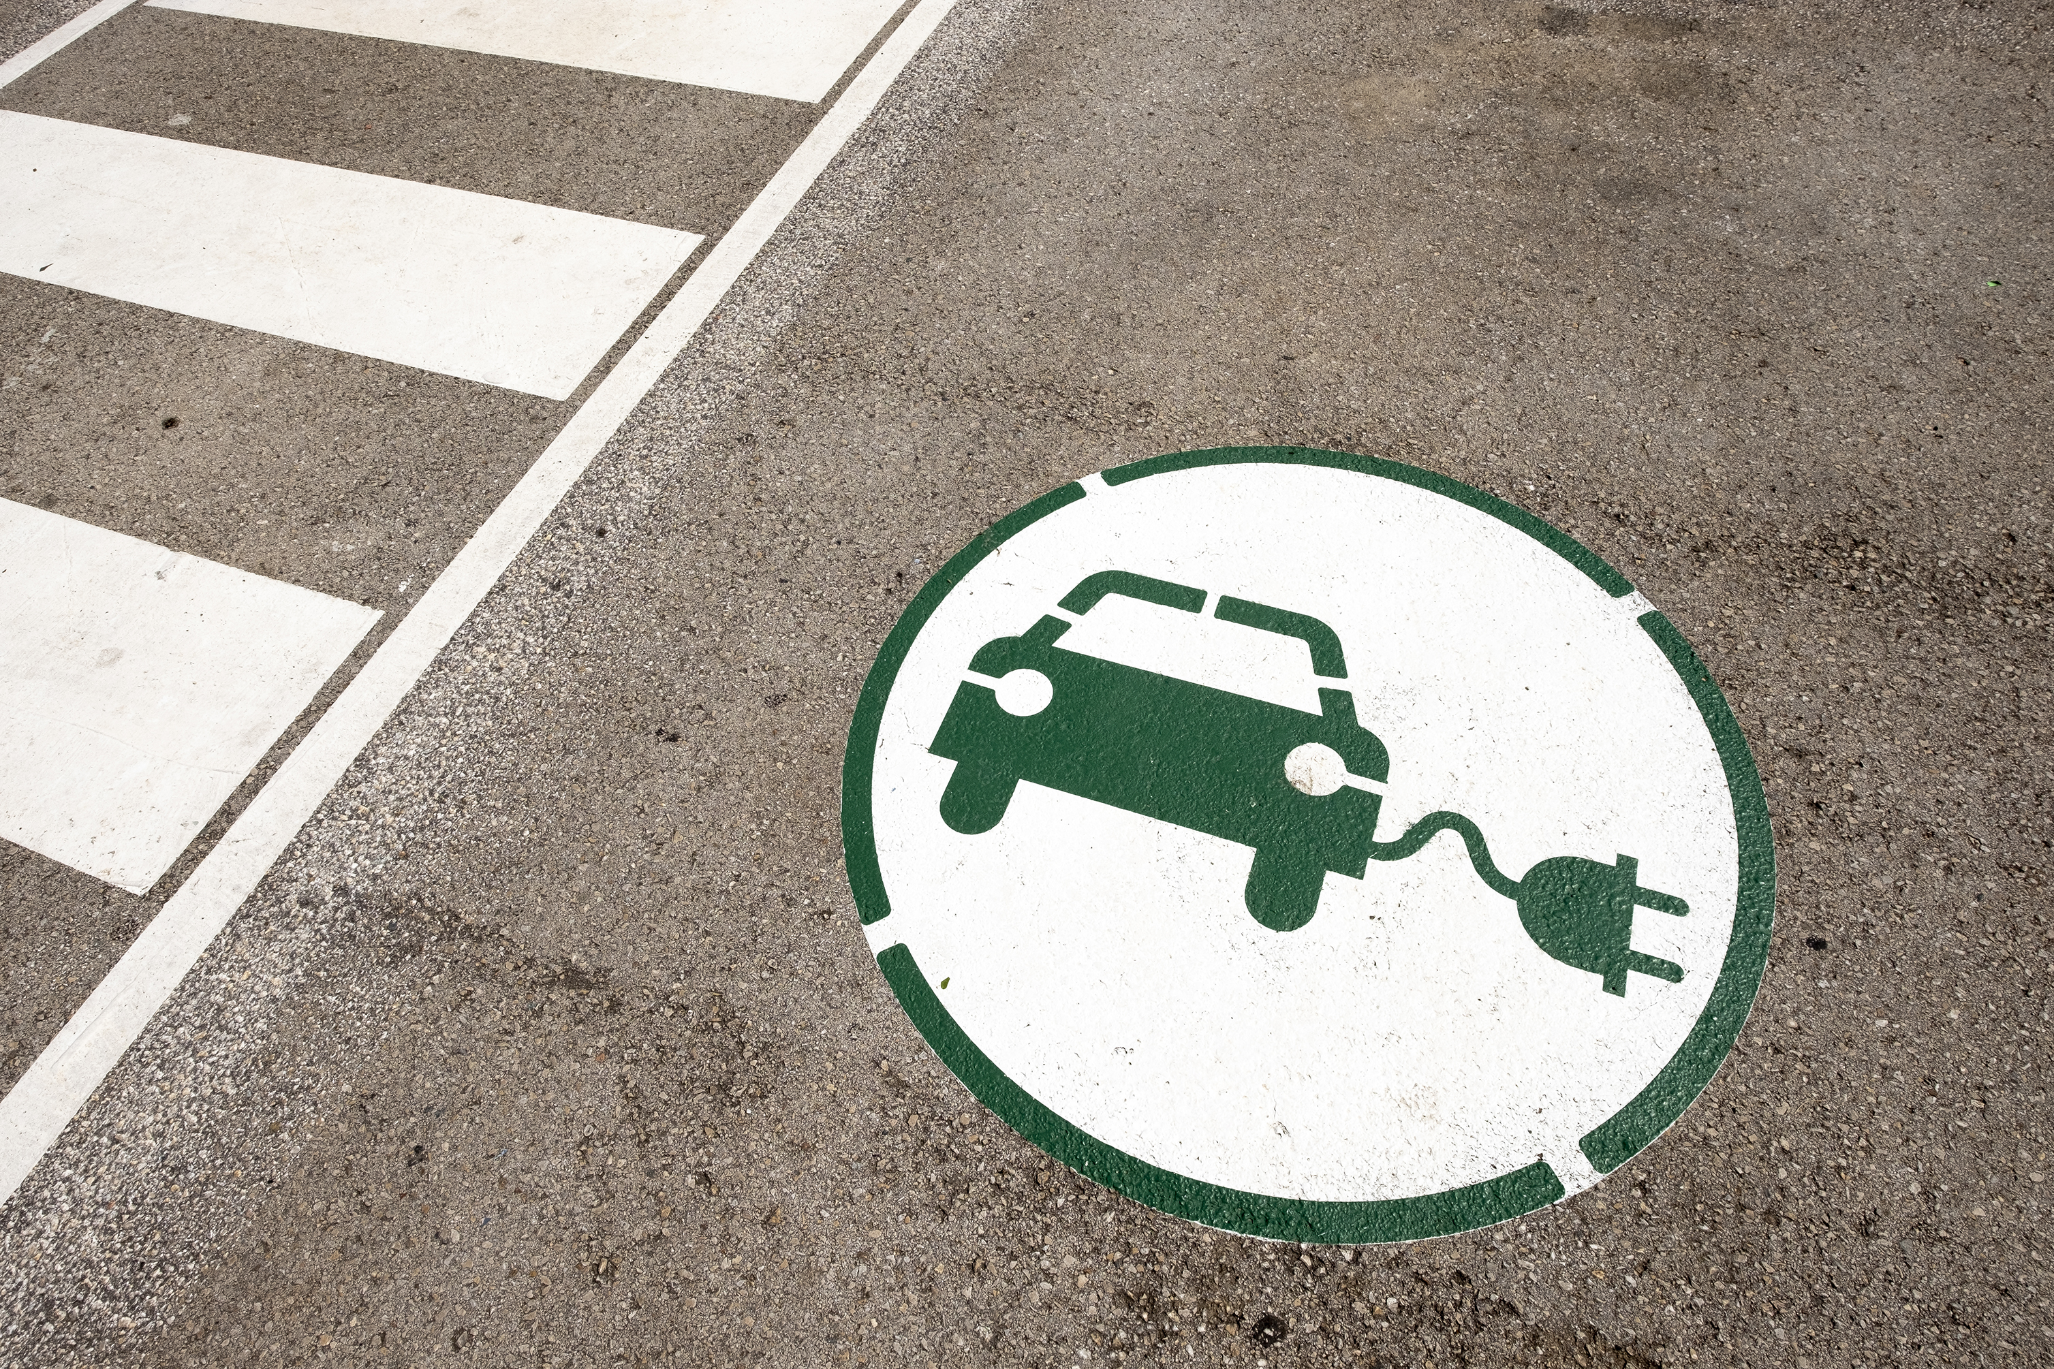
1. Executive Summary
In this case study, we present the successful journey of Positive Charge, an industry-leading provider of EV charging solutions, in transforming the charging operations of an EV fleet management company. This case outlines the challenges that the customer faced, our approach to those challenges, and the noteworthy results we achieved.

Slide 3


2. Introduction: Empowering EV Fleet Operations
The introduction sets the context for our case study. It delves into the world of EV fleets and the critical role of efficient charging infrastructure. Positive Charge, a trusted partner in EV charging solutions, collaborated with a forward-thinking EV fleet management company to address their charging challenges.
3. Statement of the Problem: Addressing Charging Bottlenecks
The case study begins by defining the problem at hand. The EV fleet management company faced a daunting challenge: Its rapidly growing EV fleet with limited infrastructure was giving way to charging bottlenecks. These bottlenecks were, in turn, causing increased downtime, thus, impacting operational efficiency and incurring unnecessary costs.

Slide 4


4. Decision Criteria and Assumptions: Guiding the Path Forward
Our decision criteria for evaluating alternatives were centered on minimizing charging-related downtime, optimizing operational costs, and ensuring scalability. Assumptions included the availability of necessary resources and the commitment to implementing the chosen solution effectively.
5. Data Analysis: Illuminating Insights
This section presents a detailed analysis of the data we collected during the case study. It includes charts, graphs, and narratives that reveal insights into charging patterns, fleet growth, and the fiscal impact of charging challenges.

Slide 5


6. Alternate Courses of Action: Exploring Solutions
We considered several alternative courses of action, including expanding charging infrastructure, optimizing charging schedules, and implementing smart charging technology. We evaluated each option thoroughly, considering its feasibility and potential impact.
7. Recommendations: Transforming Charging Operations
Based on the comprehensive analysis, we recommend implementing an integrated charging solution that includes infrastructure expansion, smart charging technology, and optimized charging schedules. This holistic approach will effectively address charging bottlenecks and drive operational efficiency.

Slide 6



8. Implementation Plan: Turning Vision Into Reality
The implementation plan outlines a step-by-step strategy to bring our recommendations to life. It includes timelines, responsibilities, budget considerations, and risk mitigation strategies.
9. Exhibits and Schedules: Visualizing the Journey
Exhibit A: Charging Infrastructure Expansion Plan
Exhibit B: Charging Optimization Schedule
Exhibit C: Smart Charging Technology Overview
Exhibit D: Risk Mitigation Plan
10. References
List all sources, references, and citations used in the case study report. Follow a consistent citation style (e.g., APA, MLA) and provide complete publication details for each source, including books, articles, websites, and interviews.

Slide 7
Business Case Study Template
Title
Introduction
TITLE
AUTHORED BY
DATE

Slide 8
1. Executive Summary
Content

Slide 9
2. Introduction: Title
Content
3. Statement of the Problem: Title
Content

Slide 10
4. Decision Criteria and Assumptions: Title
Content
5. Data Analysis: Title
Content

Slide 11
6. Alternate Courses of Action: Title
Content
7. Recommendations: Title
Content

Slide 12
8. Implementation Plan: Title
Content
9. Exhibits and Schedules: Title
Content
10. References
Content
Provided by Smartsheet, Inc.

Slide 13
DISCLAIMER Any articles, templates, or information provided by Smartsheet on the website are for reference only. While we strive to keep the information up to date and correct, we make no representations or warranties of any kind, express or implied, about the completeness, accuracy, reliability, suitability, or availability with respect to the website or the information, articles, templates, or related graphics contained on the website. Any reliance you place on such information is therefore strictly at your own risk.

