Slide 1



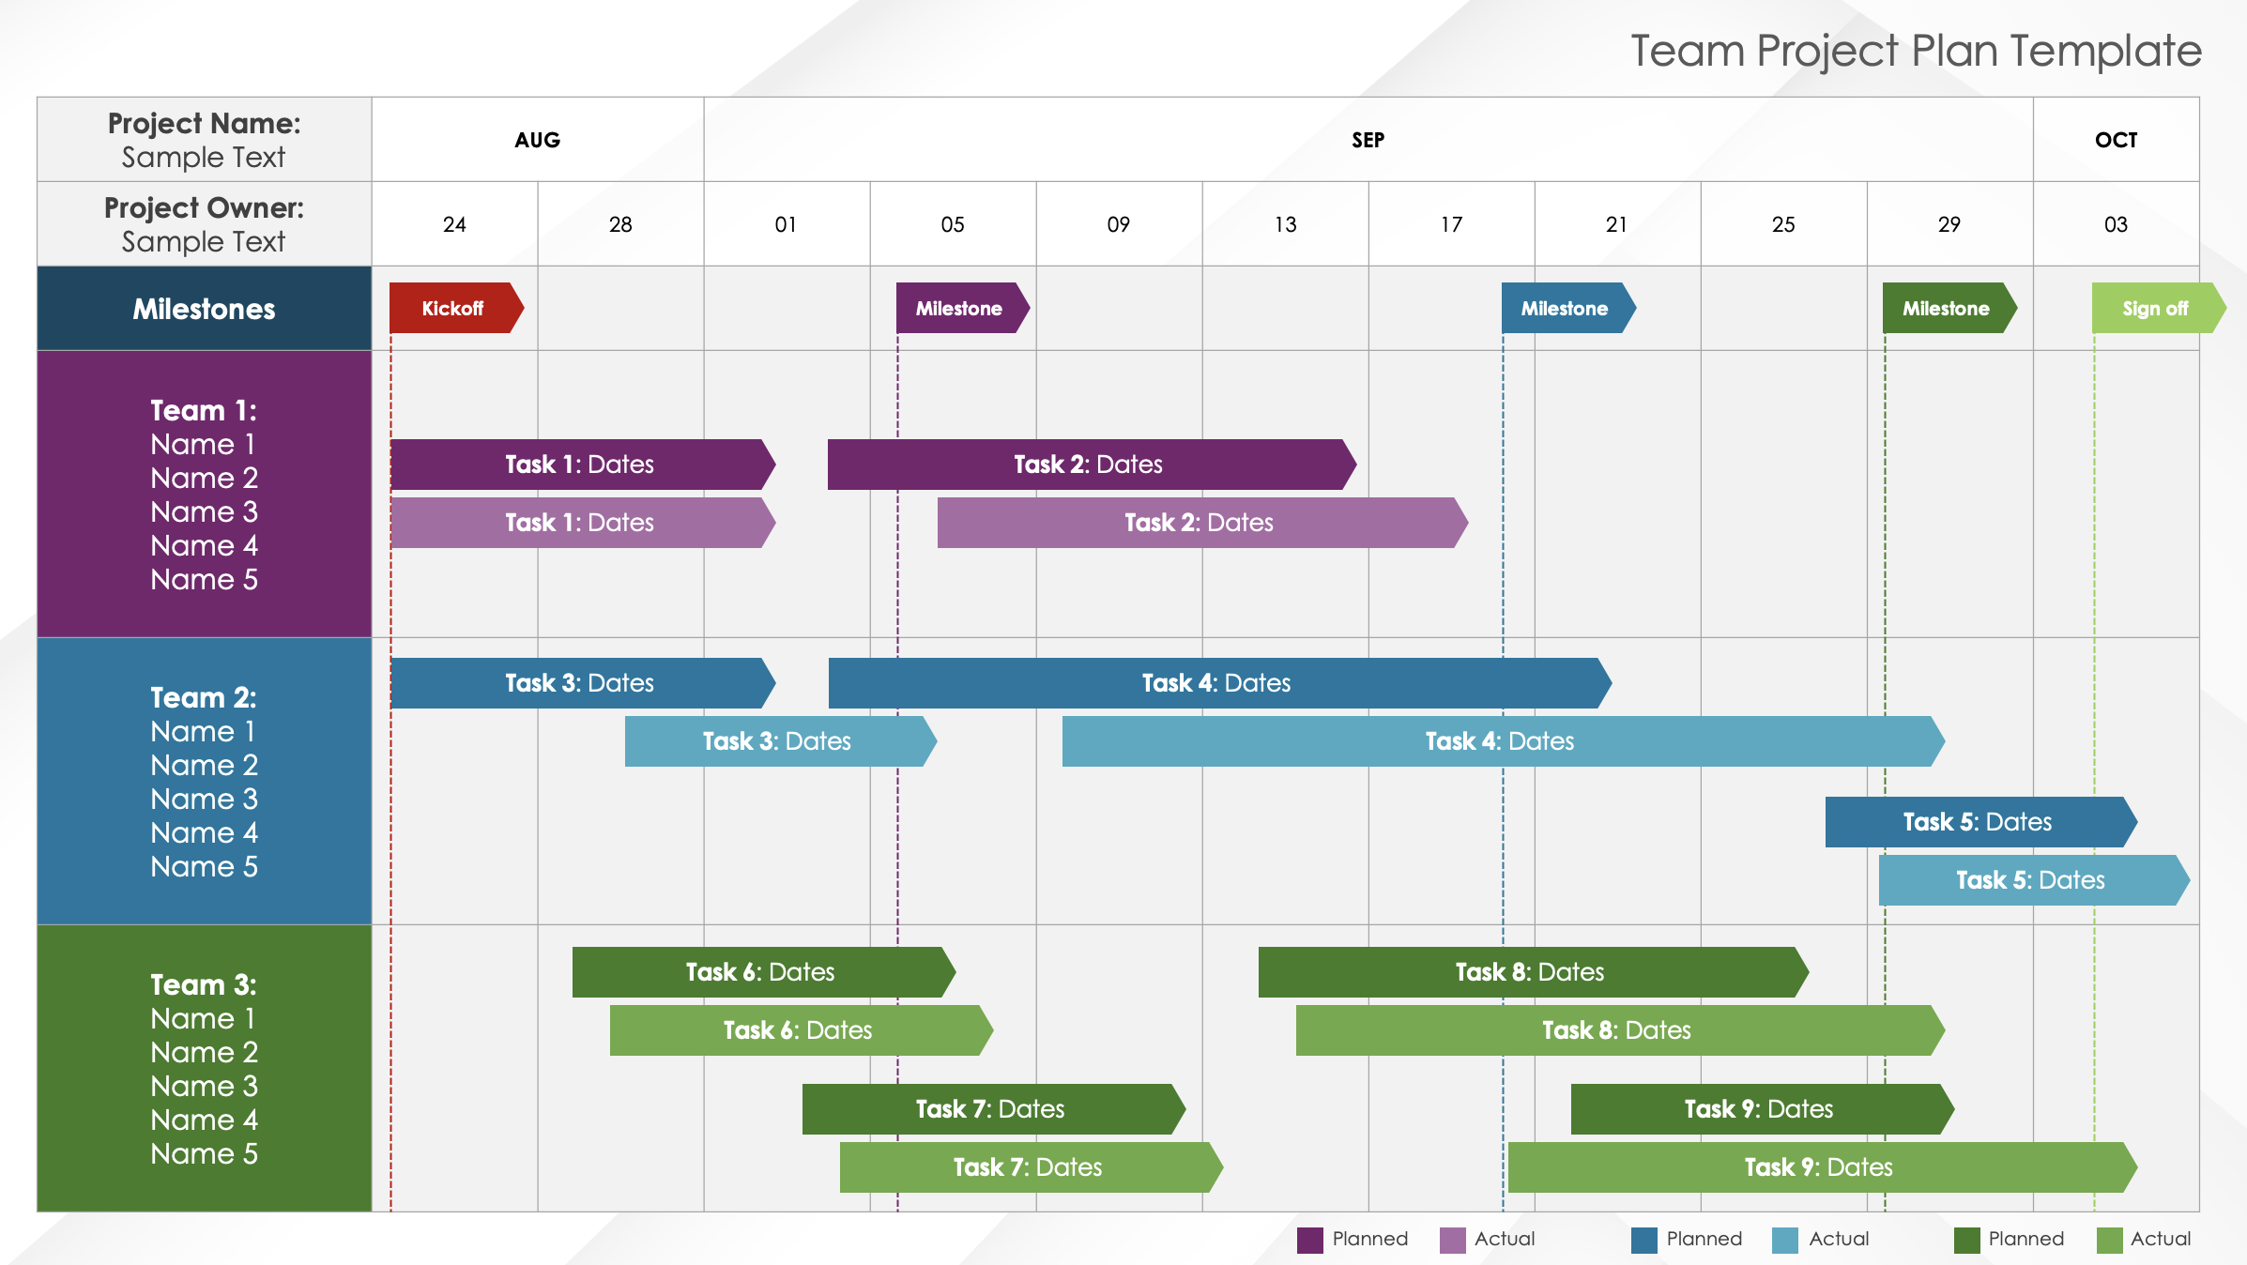
Team Project Plan Template
When to Use This Template: Use this single-slide template to present how each team is progressing through their assigned tasks, as compared to the planned durations.
Notable Template Features: This template displays task progress with two duration bars: one shows the planned duration and the other shows the actual duration. This comparison enables you to adjust deadlines as needed and forecast the timeline of future project tasks. The template also includes milestone markers so you can assess your progress.

Slide 2
Team Project Plan Template
Project Name: Sample Text | AUG |  | SEP |  |  |  |  |  |  |  | OCT
Project Owner: Sample Text | 24 | 28 | 01 | 05 | 09 | 13 | 17 | 21 | 25 | 29 | 03
Milestones
Team 1: Name 1 Name 2 Name 3 Name 4 Name 5
Team 2: Name 1 Name 2 Name 3 Name 4 Name 5
Team 3: Name 1 Name 2 Name 3 Name 4 Name 5
Kickoff
Milestone
Milestone
Milestone
Sign off
Task 1: Dates
Task 2: Dates
Task 1: Dates
Task 2: Dates
Task 3: Dates
Task 4: Dates
Task 3: Dates
Task 4: Dates
Task 5: Dates
Task 5: Dates
Task 6: Dates
Task 8: Dates
Task 6: Dates
Task 8: Dates
Task 7: Dates
Task 9: Dates
Task 7: Dates
Task 9: Dates
Planned
Actual
Planned
Actual
Planned
Actual

Slide 3
DISCLAIMER Any articles, templates, or information provided by Smartsheet on the website are for reference only. While we strive to keep the information up to date and correct, we make no representations or warranties of any kind, express or implied, about the completeness, accuracy, reliability, suitability, or availability with respect to the website or the information, articles, templates, or related graphics contained on the website. Any reliance you place on such information is therefore strictly at your own risk.

