Slide 1



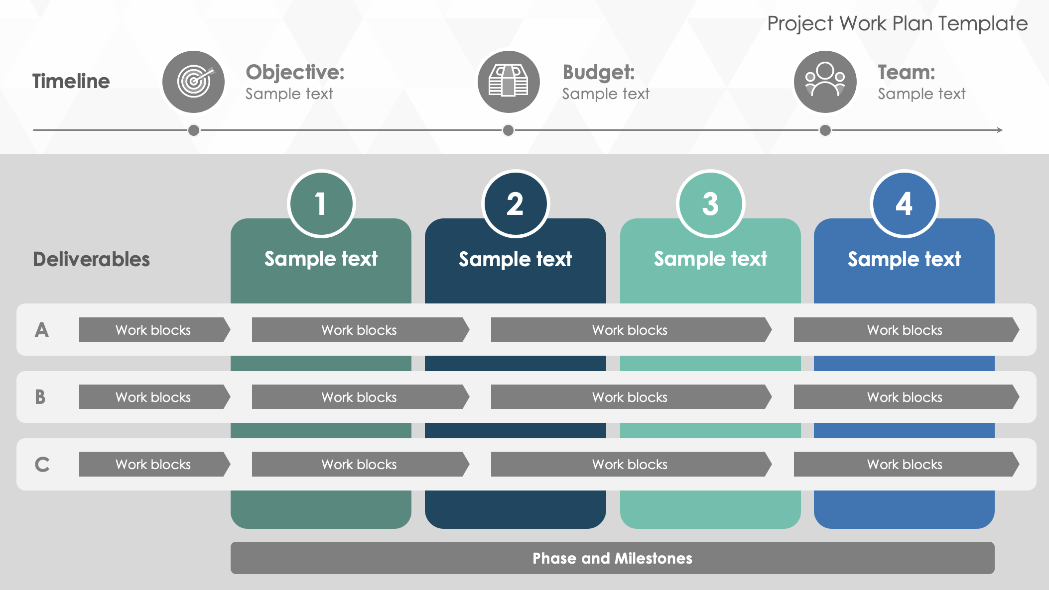
Project Work Plan Template
When to Use This Template: Use this single-slide template to present the objectives, budget, team members, and schedule of your work plan.
Notable Template Features: This template includes space to note the key elements of a project plan, including timelines, objectives, budget, and team. The numbered columns show tasks moving from left to right, making it easy for team members to understand the project’s scope and grasp each section’s information.

Slide 2



Project Work Plan Template
Timeline
Objective:
Sample text
Budget:
Sample text
Team:
Sample text
1
2
3
4
Sample text
Sample text
Sample text
Sample text
Deliverables
A
Work blocks
Work blocks
Work blocks
Work blocks
B
Work blocks
Work blocks
Work blocks
Work blocks
C
Work blocks
Work blocks
Work blocks
Work blocks
Phase and Milestones

Slide 3
DISCLAIMER Any articles, templates, or information provided by Smartsheet on the website are for reference only. While we strive to keep the information up to date and correct, we make no representations or warranties of any kind, express or implied, about the completeness, accuracy, reliability, suitability, or availability with respect to the website or the information, articles, templates, or related graphics contained on the website. Any reliance you place on such information is therefore strictly at your own risk.

