Slide 1



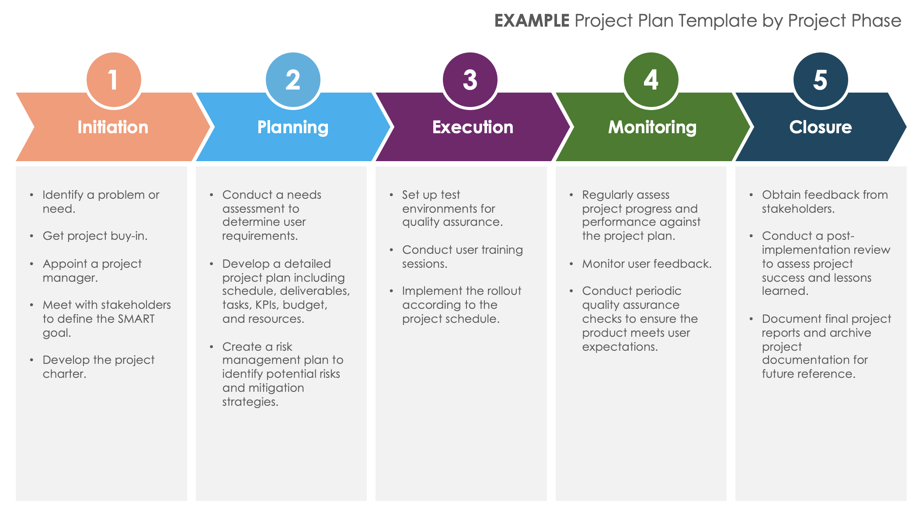
Project Plan Template by Project Phase
When to Use This Template: Use this single-slide template to visualize your project in the five official project management phases (initiation, planning, execution, monitoring, closure), as well as the tasks associated with each one.
Notable Template Features: This template visually separates the five phases of project management with distinct colors and illustrates the sequential steps from project initiation to closure. Customize the sample data to fit your project and show the deliverables of each phase or download the blank version and enter your project details.

Slide 2
EXAMPLE Project Plan Template by Project Phase
1
2
3
4
5
Initiation
Planning
Execution
Monitoring
Closure
Identify a problem or need.
Get project buy-in.
Appoint a project manager.
Meet with stakeholders to define the SMART goal.
Develop the project charter.
Conduct a needs assessment to determine user requirements.
Develop a detailed project plan including schedule, deliverables, tasks, KPIs, budget, and resources.
Create a risk management plan to identify potential risks and mitigation strategies.
Set up test environments for quality assurance.
Conduct user training sessions.
Implement the rollout according to the project schedule.
Regularly assess project progress and performance against the project plan.
Monitor user feedback.
Conduct periodic quality assurance checks to ensure the product meets user expectations.
Obtain feedback from stakeholders.
Conduct a post-implementation review to assess project success and lessons learned.
Document final project reports and archive project documentation for future reference.

Slide 3
Project Plan Template by Project Phase
1
2
3
4
5
Phase Title
Phase Title
Phase Title
Phase Title
Phase Title
Description
Description
Description
Description
Description
Description
Description
Description
Description
Description
Description
Description
Description
Description
Description
Description
Description
Description
Description
Description
Description
Description
Description
Description
Description

Slide 4
DISCLAIMER Any articles, templates, or information provided by Smartsheet on the website are for reference only. While we strive to keep the information up to date and correct, we make no representations or warranties of any kind, express or implied, about the completeness, accuracy, reliability, suitability, or availability with respect to the website or the information, articles, templates, or related graphics contained on the website. Any reliance you place on such information is therefore strictly at your own risk.

