Slide 1

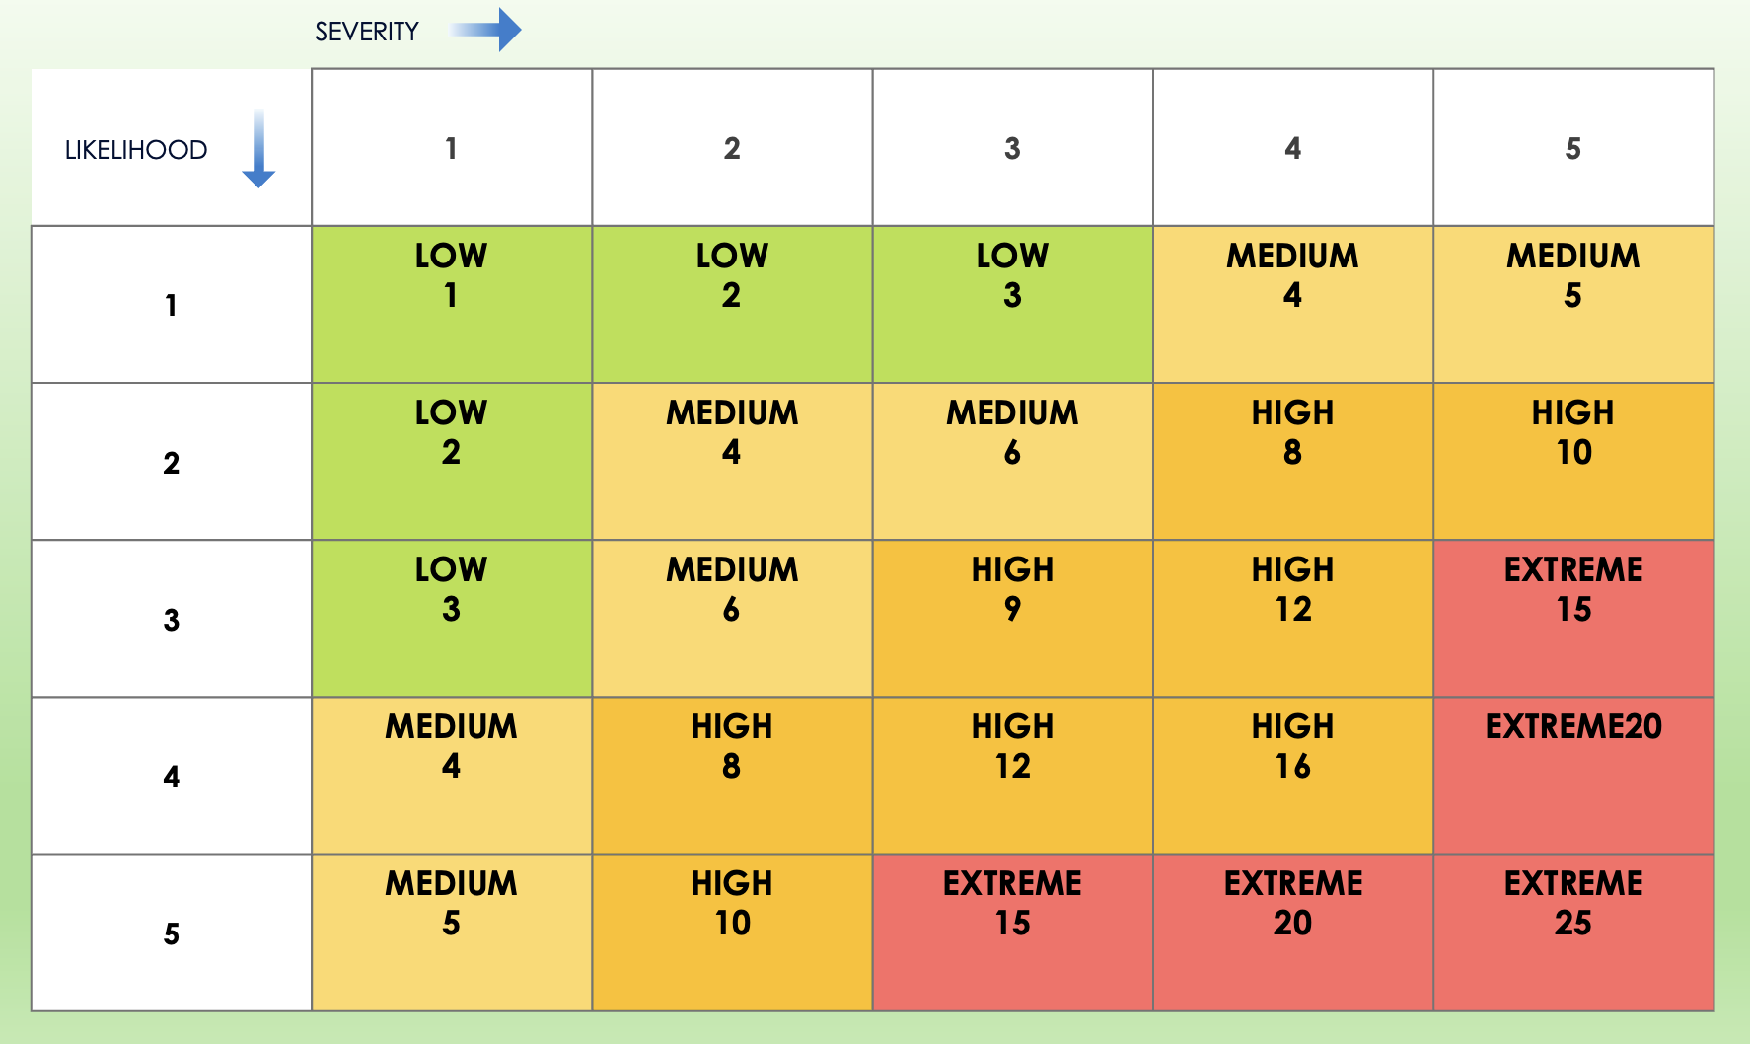
5x5 Risk Matrix Template

Slide 2
5X5 MATRIX
SEVERITY
 | 1 | 2 | 3 | 4 | 5
1 | LOW 1 | LOW 2 | LOW 3 | MEDIUM 4 | MEDIUM 5
2 | LOW 2 | MEDIUM 4 | MEDIUM 6 | HIGH 8 | HIGH 10
3 | LOW 3 | MEDIUM 6 | HIGH 9 | HIGH 12 | EXTREME 15
4 | MEDIUM 4 | HIGH 8 | HIGH 12 | HIGH 16 | EXTREME20
5 | MEDIUM 5 | HIGH 10 | EXTREME 15 | EXTREME 20 | EXTREME 25
LIKELIHOOD
Provided by Smartsheet, Inc.

Slide 3
DISCLAIMER Any articles, templates, or information provided by Smartsheet on the website are for reference only. While we strive to keep the information up to date and correct, we make no representations or warranties of any kind, express or implied, about the completeness, accuracy, reliability, suitability, or availability with respect to the website or the information, articles, templates, or related graphics contained on the website. Any reliance you place on such information is therefore strictly at your own risk.

